Slide 1
Analyze Placement Data
BRAIN DEAD
PROJECT REPORT ON:-
2. Detecting Emotional Sentiment in Cartoons​
BY: TEAM RANKER

Slide 2





Meet our team
Anjali Singh
Ayushi Agarwal
Jhanvi Gupta
Namrata Singh
C S Hari Chandana
​
Team Leader

Slide 3
Problem statement 1: Analyze Placement Data
BrainDead2k23

Slide 4

INDEX
Factors affecting placements?
Which degree specializations are in high demand in the industry?
Does MBA percentage matter in placement?
Bibliography

Slide 5
WHAT ARE THE FACTORS AFFECTING PLACEMENTS?

Slide 6
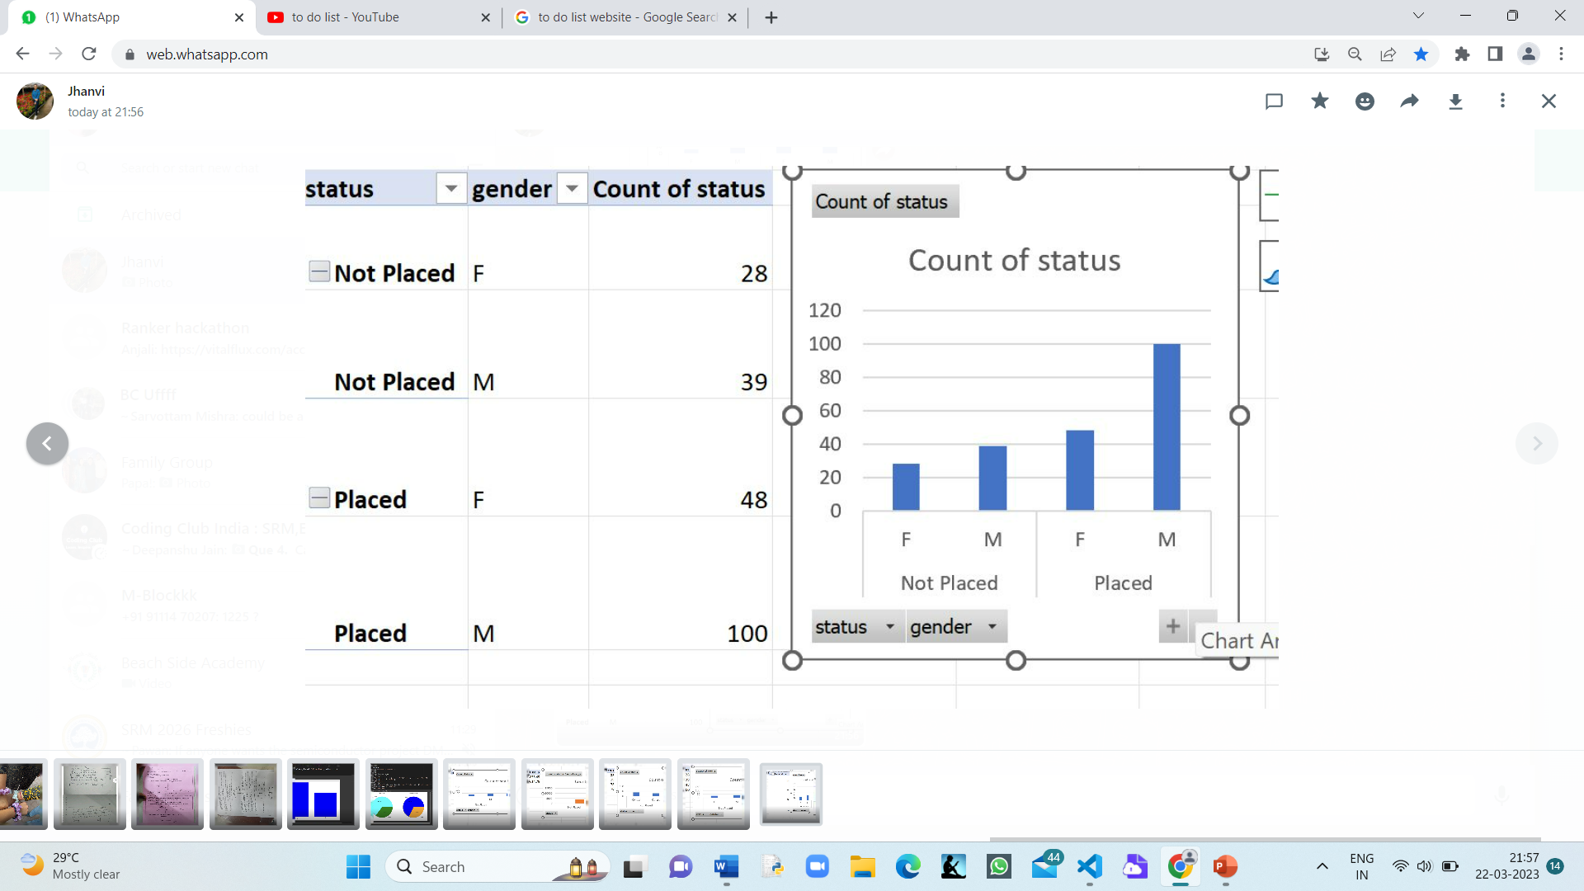
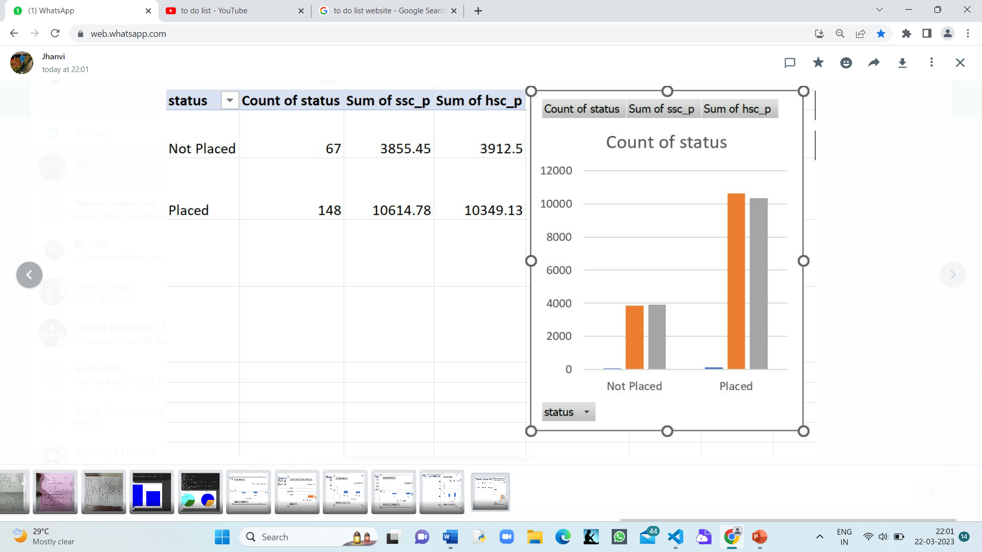
PLACEMENT vs GENDER
On analysing the dataset following conclusions are made:-
Out of 76 women,48 are placed
Out of 139 men,100 are placed
More percentage of males are placed than females.
PLACEMENT vs SSC N HSC MARKS
On analysing the dataset following conclusions are made:-
More SSC n HSC marks more better placed are the people.

Slide 7
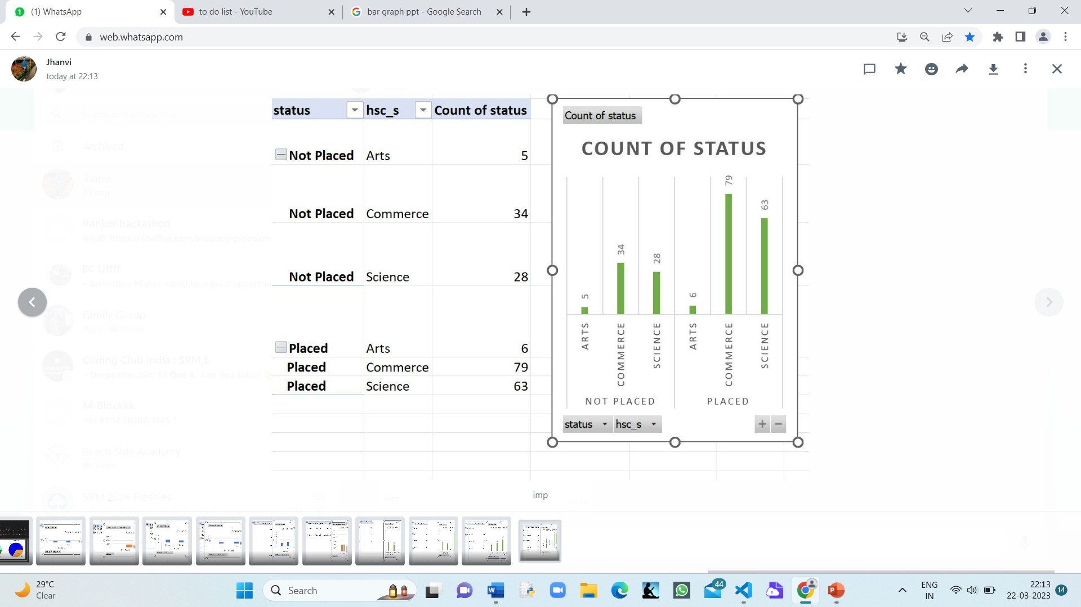
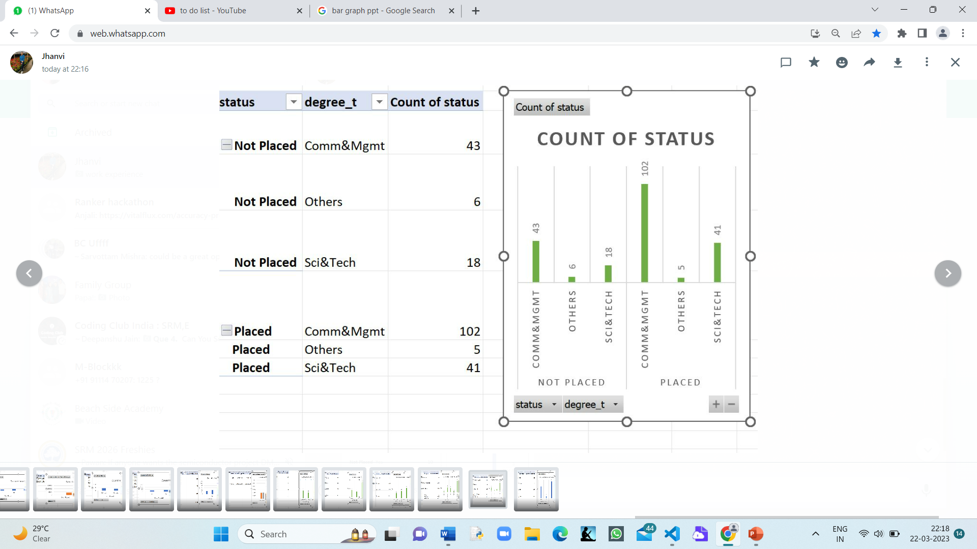
PLACEMENT vs SPECIALIZATION IN HSC
On analysing the dataset following conclusions are made:-
Out of 148 placed: 79 are from commerce.63 science,6 arts
Out of 67 placed: 34 are from commerce,28 are from science,5 from arts
PLACEMENT vs UGD DEGREE
On analysing the dataset following conclusions are made:-
Comm & Mgmt are better placed than others. Total 102 are placed out of 145
Sci &Tech 41 are placed of the total 59

Slide 8
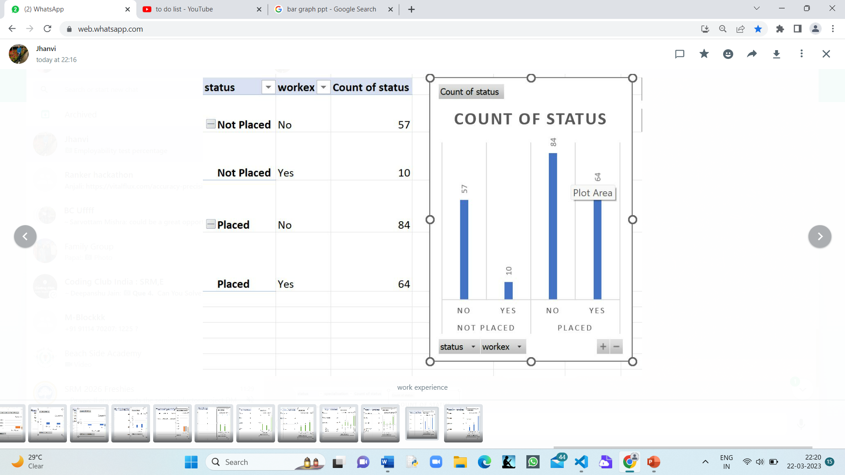
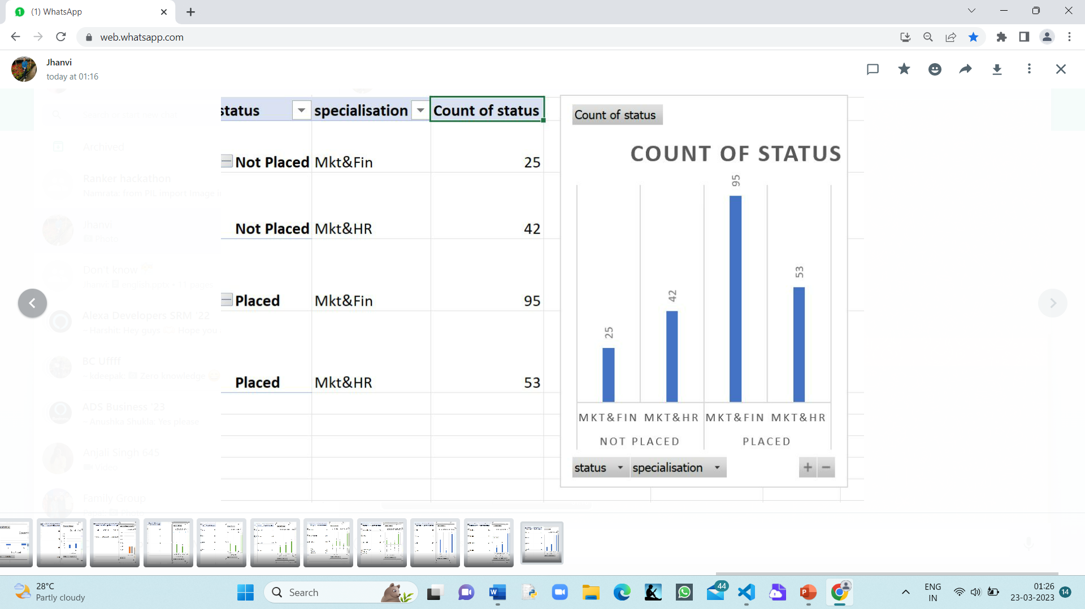
PLACEMENT vs WORK EXP
On analysing the dataset following conclusions are made:-
Work Experience really doesn't matter in the placement
as people without the work experience are far better placed than the ones with work experience.
PLACEMENT vs POST GRAD SPECIALISATION
On analysing the dataset following conclusions are made:-
Post Grad has a significant impact on the placements
People who took post grad in Mkt & Fin are better placed than the ones with no post grad.
People who took post grad in Mkt & HR are better placed than the ones with no post grad.

Slide 9
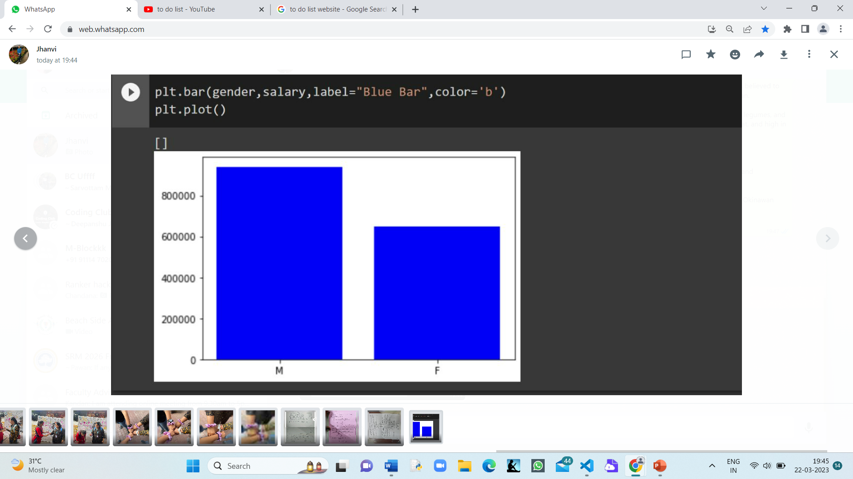
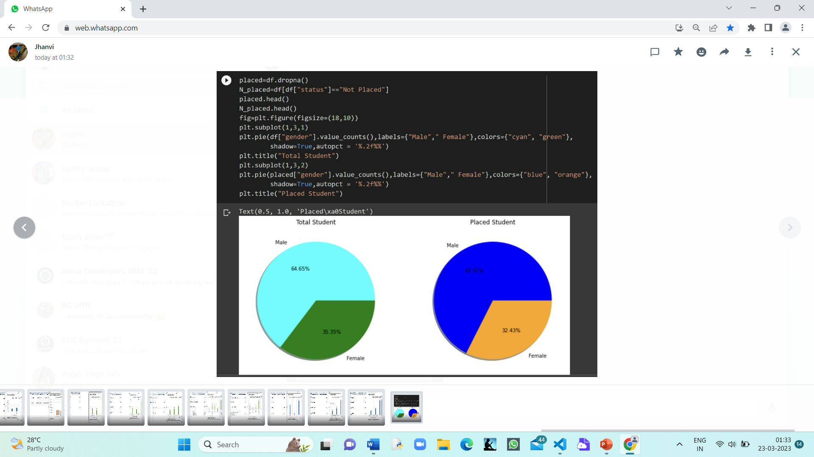
Scale:-
X axis: Gender
Y axis: Salary
1 unit=200000 rupees
On analysing the dataset following conclusions are made:-
More males are placed than females.
The average salary of males is more than that of women
GENDER vs SALARY

Slide 10
WHICH DEGREE SPECIALIZATIONS ARE IN HIGH DEMAND IN THE INDUSTRY?

Slide 11
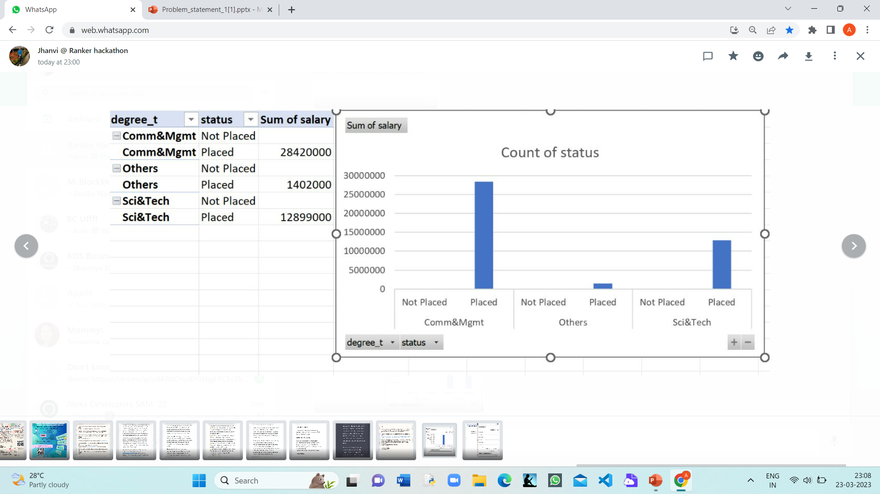
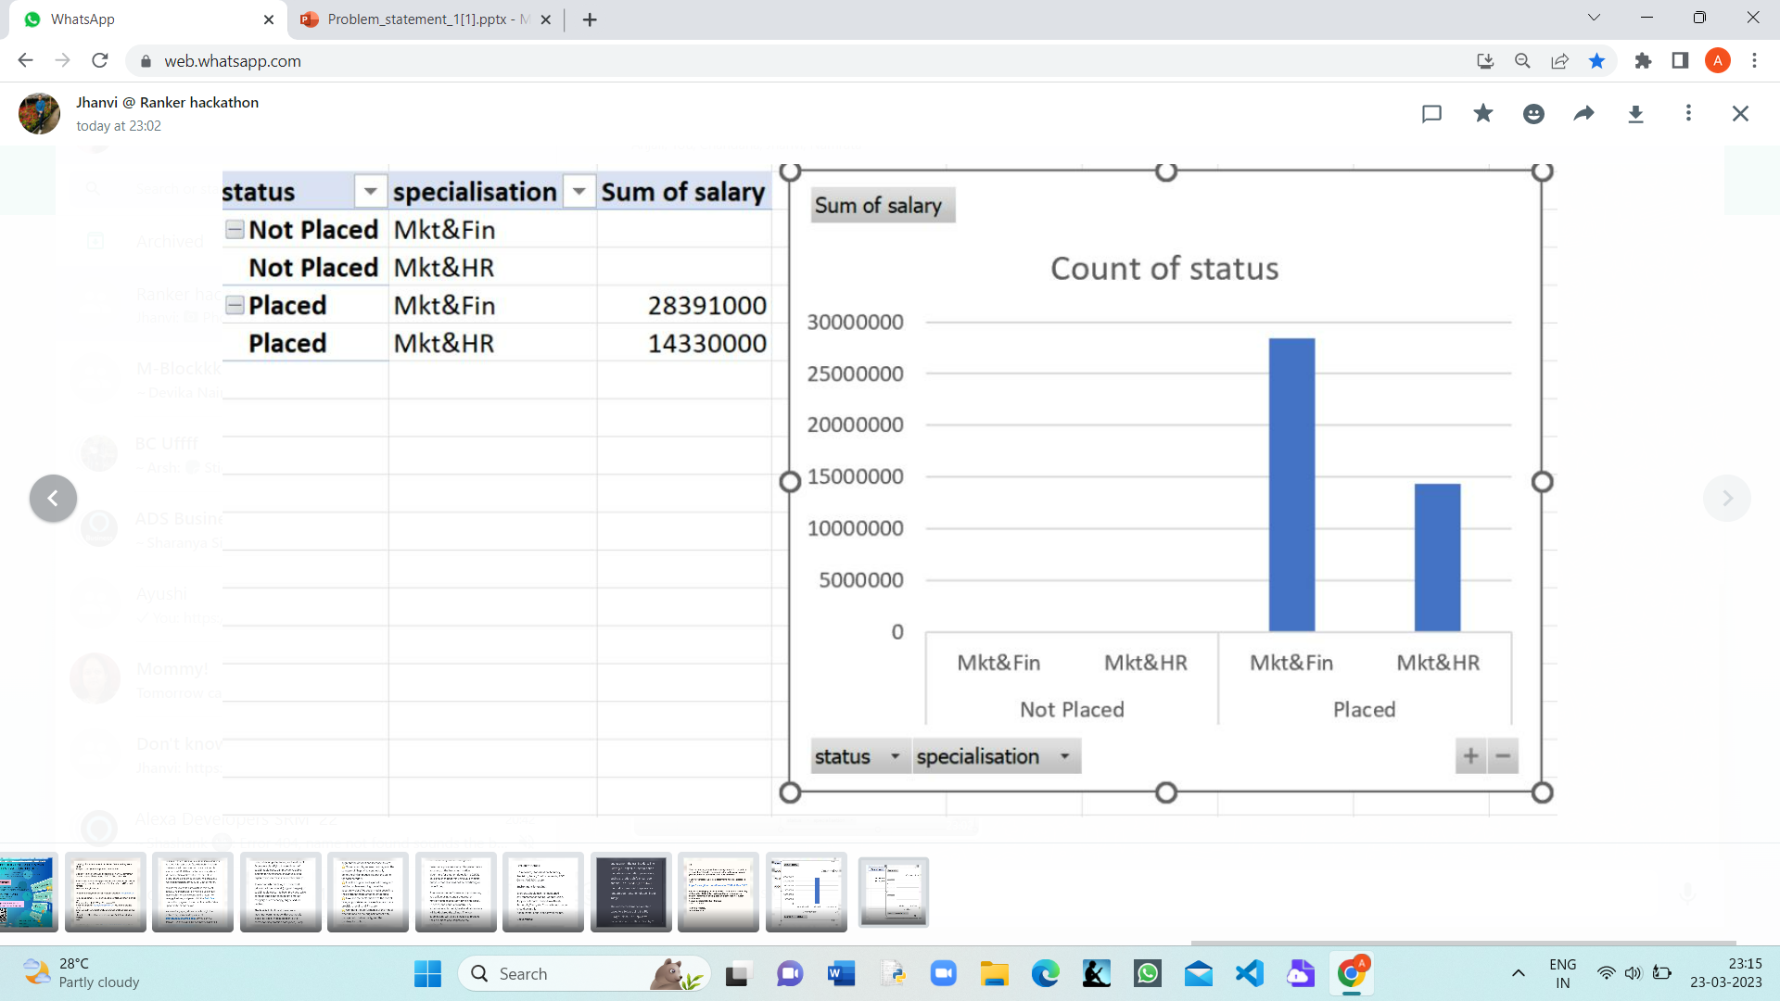
Scale:-
X axis-degree and placement
Y axis –salary
On analysing the dataset following conclusions are made:-
Comm & Mgmt are in high demand as more better placed and more salary than others.
Mkt & Fin are in high demand as more better placed and more salary than others.

Slide 12
DOES MBA PERCENTAGE MATTER IN PLACEMENT?

Slide 13
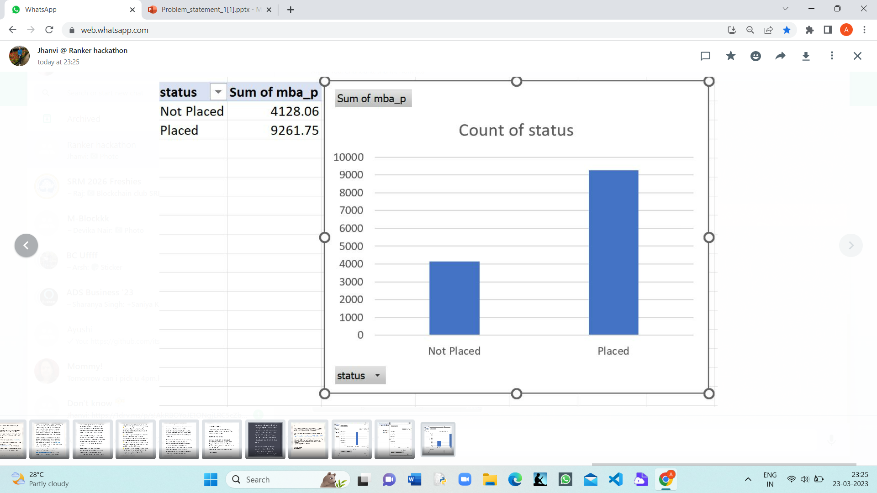
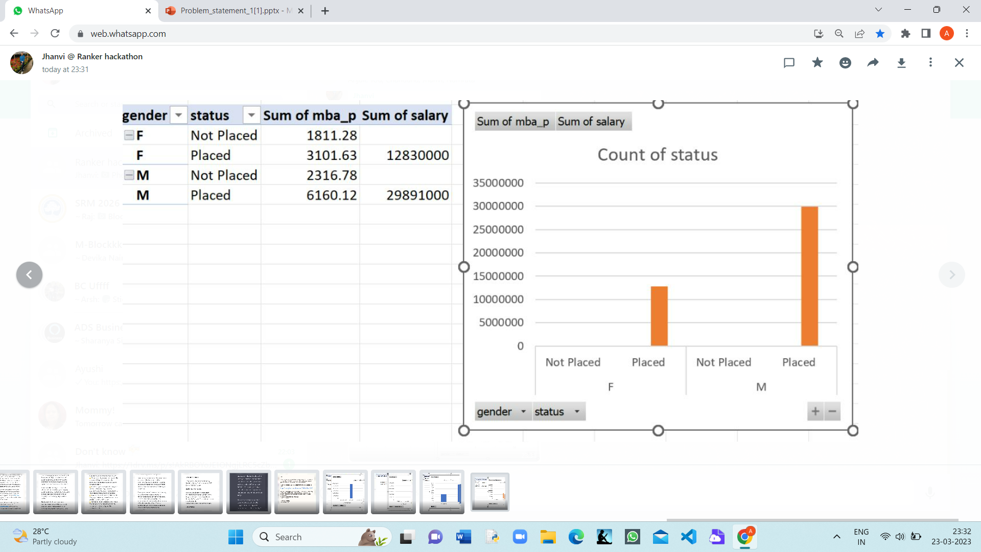
Yes,
MBA percentage plays a significant role in placement as seen from the bar graph.
More better placed are men than women with the same MBA degree.

Slide 14
Bibliography
https://colab.research.google.com/notebooks/charts.ipynb#scrollTo=SZ-DMbnPMbMY
https://youtu.be/BHQ92m-cYug

Slide 15
Presentation 2: Detecting Emotional Sentiment in Cartoons
Brain Dead 2k23

Slide 16
INTRODUCTION
•Machine learning is a branch of artificial intelligence and computer science which focuses on the use of data and algorithms to imitate the way that humans learn, gradually improving its accuracy. Supervised machine learning builds a model that makes predictions based on evidence in the presence of uncertainty.
•A supervised learning algorithm takes a known set of input data and known responses to the data (output) and trains a model to generate reasonable predictions for the response to new data.
Our team has made a program regarding Detecting Emotional Sentiment in Cartoons by using
Google Colab. We have imported various libraries like matplotlib, numpy , PIL, tensor flow.
•In our project we train the system to recognize Emotional Sentiment in Cartoons to gain insights into user behavior, preferences, and sentiment. Accurately classifying the sentiment of social media posts can provide valuable insights for businesses, individuals, and organizations to make informed decisions.

Slide 17
HACKATHON PROJECT PROPOSAL
The hackathon started from 22 March and was up to 24 March 2023
Objective : Our objective is to build and fine-tune a machine-learning model that accurately classifies social media posts into their corresponding emotion categories, using synthetic images.
1 st set of code : IMPORTING ALL NECESSARY LIBRARIES AND ENTERING AND FEEDING THE DATASET TO THE MODEL.
2ND set of code : TRAIN THE MODEL USING THE SAVED DATA.
AFTER TRAINING WE HAVE RUN TEST CASES
3rd set of code : CALCULATED THE ACCURACY.

Slide 18
WHY SHOULD ONE CHOOSE OUR SOLUTION?
We have unique solution to the problem of emotion detection of cartoons.
We can train the system for ‘N’ no. Of cartoons to register , save and recognize new inputs successfully.

Slide 19
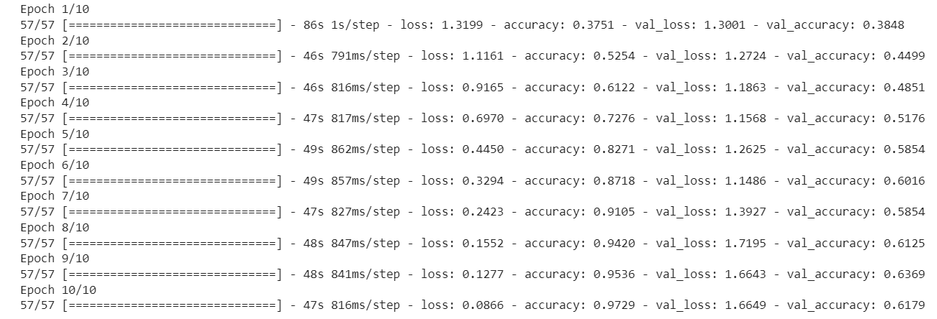
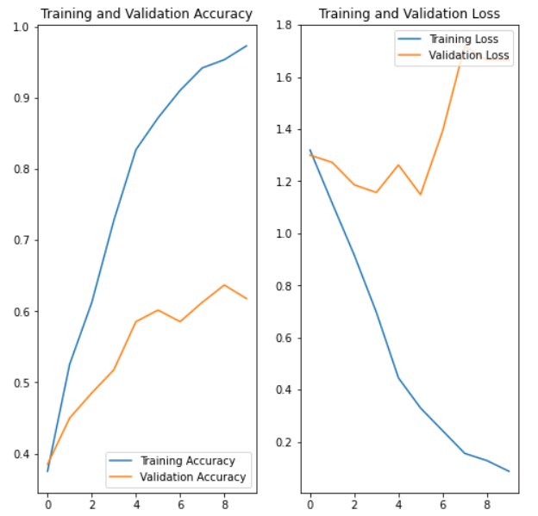
OUTCOMES
TRAINING DATASET

Slide 20
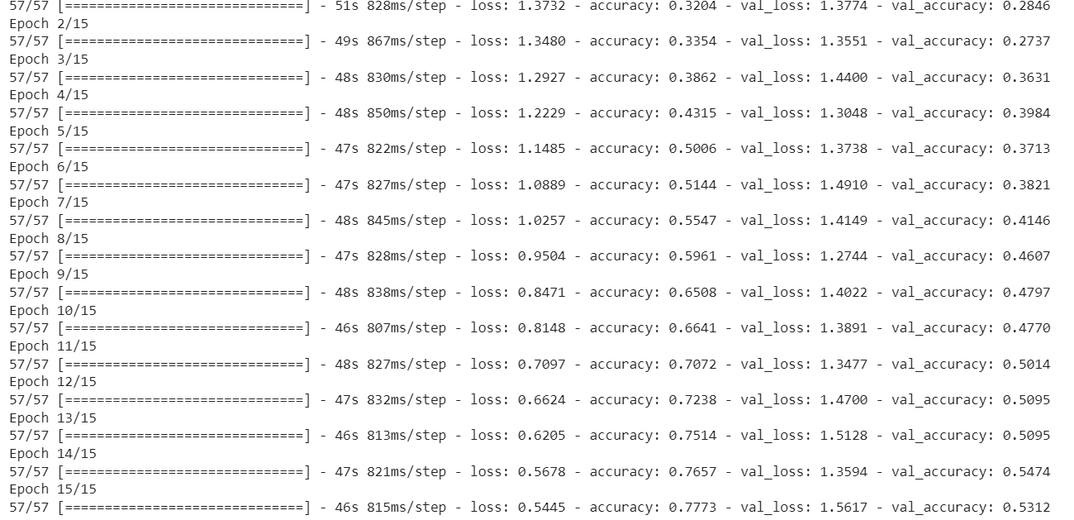
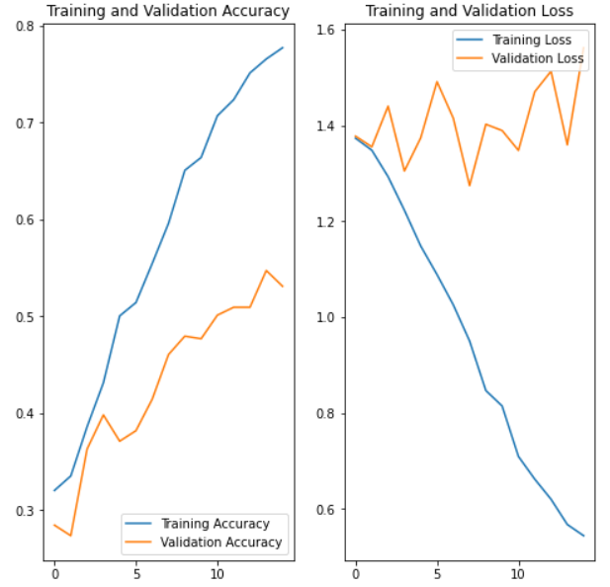
TEST DATASET

Slide 21
BIBLOGRAPHY
https://towardsdatascience.com/create-a-synthetic-image-dataset-the-what-the-why-and-the-how-f820e6b6f718
https://medium.com/featurepreneur/generate-synthetic-image-data-for-your-next-machine-learning-project-74cf71b65a8f
https://vitalflux.com/accuracy-precision-recall-f1-score-python-example/

Slide 22
Thank you

